Slide 1
Industrial Chemistry I
(Chem. 352)
Amare Aregahegn (PhD)
amare2122@gmail.com
Addis Ababa University
2015 E.C
@Amare Aregahegn

Slide 2
Chapter 2:
Water in the chemical industry
@Amare Aregahegn

Slide 3
  Introduction
  Cavendish (1731 – 1810) discovered the composition of water (H₂O). Like air, water is one of the few basic materials which are of prime importance for the preservation of life on this earth.
  Without water there is no life.
  70% of planet earth is covered by water. Water is precious why? Because from 70% of earth’s water: about 97.4% of the total water on earth is in seas and oceans. About 2% of water is frozen in glaciers and in polar ice caps. The remaining i.e., only 0.6% is available as freshwater in the liquid form.
@Amare Aregahegn

Slide 4
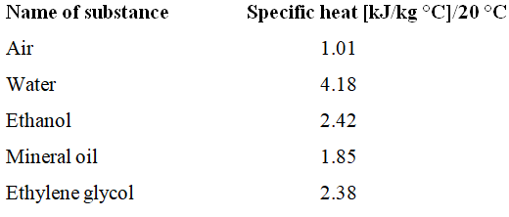
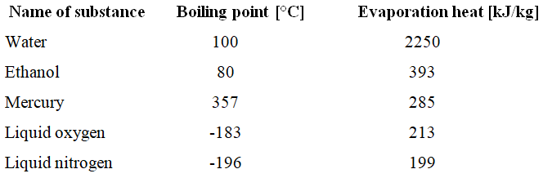
Water is used as a cooling purpose as well as for heating purpose. Why not other liquids used for such purpose?
Chemically stable:
Water has a large specific heat
High evaporation heat
@Amare Aregahegn

Slide 5
2.3. Sources of water
Water is available in nature in abundance. It is essentially a constituent of all animal and vegetable matter. The main sources of water are:
Rain water
Lake water
River water
Sea water
Spring or well water
Rain water: Rain water is the purest form of natural water. However, it contains considerable amount of dissolves gases (CO₂ – SO₂ - NO –NO₂ …etc.) and suspended solid particles from atmosphere, during its journey through it and becomes polluted.
River water: River is formed by rain and spring waters. It contains salts and organic matter. During its flow over the surface of land, it dissolves minerals of the soil such as chlorides, sulfates, bicarbonates of sodium, calcium, magnesium ions etc. The organic matter is due to decaying plants, dead bodies of animals etc.
@Amare Aregahegn

Slide 6
Sea water: It is the most impure form of natural water. It contains larger percentage of the dissolved salts (above 3.5%) out of which about 2.6% is NaCl. The NaCl which is present in the dissolved form in sea water will come out as NaCl crystals due to evaporation of sea water. The other salts present in the sea water are sulphates of sodium, bicarbonates of potassium, magnesium, calcium, bromides of potassium, magnesium etc.
Lake Water: it contains constant chemical composition, not always constant, it may vary. When water inters to the lake, the particles settle down and becomes somewhat pure b/c the water do not move. The minerals present in the lake water are in dissolved form and exhibits high quantity of organic matter. Lake also contains salt and decaying.
Underground water: Spring & well waters are the underground water sources. They are in generally clearer in appearance due to the filtering action of the soil. They contain more of the dissolved salts generally; underground water is of high organic purity.
@Amare Aregahegn

Slide 7
What is the difference between well and spring water?
Well water comes to the ground by mechanical force but spring water is a water that come to the ground without mechanical force i.e. it comes by its own internal force.
Clean from organic matter b/c during its journey, the soil itself acts as a filter.
Both contain high content of salt why?
Since it is free from organic matter, they are safe to use than surface water. Continuously you can’t use well water b/c all the salt will deposit in your kidney and finally develop kidney salts.
@Amare Aregahegn

Slide 8
2.4. Dissolved solids, suspended solids, Hardness and alkalinity in water
2.4.1. Types of impurities in water:
The impurities present in natural waters may be broadly classified as follows:
1. Dissolved impurities
A. Inorganic salts: e.g.
Cations:Ca^{2+,} Mg^{2+,} Na⁺, K⁺, Fe^{2+,} Al³⁺ and sometimes traces of Zn²⁺ and Cu²⁺
ii. Anions: Cl⁻, SO₄^{2-,} NO₃⁻, HCO₃⁻, and sometimes F⁻ and NO₂⁻
B. Gases: e.g., CO₂, O₂, N₂, oxides of N₂ and sometimes NH₃, H₂S
C. Organic salts: Organic water products, amino acids, proteins, etc.
2. Suspended impurities
A. Inorganic e.g., clay and sand
B. Organic matter e.g., vegetable, animal matter and oil globules
@Amare Aregahegn

Slide 9
3. Albunoid ammonia:
Finally divided clay and silica, aluminum hydroxide, ferric hydroxide, organic waste products, humic acids, colouring matter, complex protein, amino acid, which are generally classified as albunoid ammonia
4. Bacterial impurities:
Presence of bacteria fungi, algae and other minute forms of vegetable and animal life are considered as biological impurities.
These may cause diseases and affect heat transfer equipment’s and also cause corrosion of metallic parts. Hence these can be removed by special processes.
@Amare Aregahegn

Slide 10
2.5. Water Quality Characteristic or Parameters
The quality of the water you consume or use in municipal or industrial processes must meet specific parameters.
There are three water quality parameters that help to measure the quality of water, which include:
The physical parameters: include color, taste, odor, temperature, turbidity, solids, and electrical conductivity.
Chemical parameters: include pH, acidity, alkalinity, chlorine, hardness, dissolved oxygen, and biological oxygen demand.
The third type of parameter involves biological parameters, which include bacteria, algae, and viruse.
@Amare Aregahegn

Slide 11
For instance, dissolved oxygen is among the most important parameters when measuring a river’s water quality.
The amount of dissolved oxygen in the water dictates how polluted the water sample is. Low amounts of dissolved oxygen indicate that the water is highly polluted and that organic contaminants are consuming the dissolved oxygen
@Amare Aregahegn

Slide 12

2.6. Hardness and Alkalinity
The most important manifestations of the dissolved mineral matter from the point of industrial application include hardness and alkalinity.
2.6.1. Hardness
Hardness was originally defined as the soap consuming capacity of a water sample. Soaps generally consist of the sodium salts of long –chain fatty acids such as oleic acid, palmetic acid and stearic acid.
The soap consuming capacity of water is mainly due to the presence of calcium and magnesium ions. These ions react with the sodium salts of long-chain fatty acids present in the soap to form insoluble scum of calcium and magnesium soaps which do not possess any detergent value.
@Amare Aregahegn

Slide 13
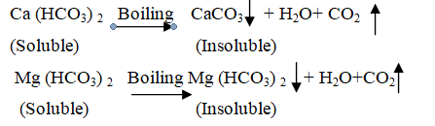
Types of Hardness: For convenience, hardness of water is of two
kinds and is classified as temporary and permanent.
Temporary hardness:
When natural water is boiled, the bicarbonate ions present are decomposed to form carbonate ions and carbon dioxide is set free. The Ca²⁺ and Mg²⁺ ions readily combine with the carbonate ions to form CaCO₃ and MgCO₃ precipitates.
Carbon dioxide escapes in air as it is not soluble at higher temperature.
@Amare Aregahegn

Slide 14
Permanent hard water:
Permanent hardness: Permanent hardness of water is due to the dissolved chlorides, sulphates and nitrates of calcium and magnesium. These salts are CaCl2, CaSO4, Ca(NO3)2, MgCl2, MgSO4, Mg(NO3)2
Water which cannot be softened by simple boiling but some type of chemical treatment is to be given due to the presence of sulphates and chlorides of calcium and magnesium, is called permanent hard water. Such type of hardness is due to cations (such as Ca²⁺, Mg²⁺, Fe⁺³, etc.,) present in it.
This Hardness cannot be removed easily by boiling. Hence it is called “Permanent Hardness”. Only chemical treatment can remove this hardness.
@Amare Aregahegn

Slide 15
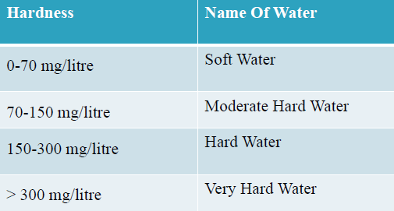
Degree of hardness:
Hence hard water is not always unfit for drinking purposes. Similarly, a soft water may contain impurities of an injurious nature, e.g., nitrogen compounds. There substances may render it unfit for drinking. Thus, soft water is also not always fit for drinking.
Water containing less than 150 ppm of hardness are classified generally as “good”, those containing 150 to 350 ppm as “fair” and those exceeding 350 ppm” bad”.
@Amare Aregahegn

Slide 16
Units of hardness:
The hardness is generally expressed in terms of the dissolved calcium and magnesium salts calculated as CaCO₃ equivalent carbonate or temporary hardness is caused due to the bicarbonates of calcium and magnesium in water and can be removed even by boiling.
These are 4 different units in which the hardness of water is expressed as given below
Parts per million (ppm): ppm is the number of parts of CaCO₃ equivalent hardness per 10⁶ parts of water. i.e., 1 ppm = 1 part of CaCO₃ equivalent hardness in 10⁶ parts of water.
Milli grams per Liter (mg/liter):
Degree of Clark (ºcl) :
Degree of French (ºFr) :
@Amare Aregahegn

Slide 17
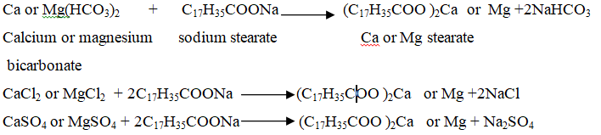
ESTIMATION OF HARDNESS
Hardness is usually determined by the following two methods:
1. Soap solution method
Soluble soaps consist of sodium or potassium salts of higher fatty acids, such as oleic acid& stearic acid.
These soaps give lather with hard water only after sufficient quantity of the soap is added to precipitate all the hardness causing metal ions present in it in the form of their respective insoluble soaps.
@Amare Aregahegn

Slide 18
Thus, after all the hardness causing metal ions present in the hard water sample are precipitated, the further addition of soap gives lather.
The total hardness of a water sample can be determined by titrating an aliquot of the sample against a standard soap solution in alcohol. The appearance of a stable lather persisting even after shaking for about 2 minutes marks end-point
@Amare Aregahegn

Slide 19
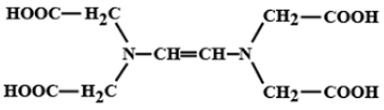
2. EDTA Method
This method gives more accurate results than the soap solution method.
Figure 2.1 Structure of EDTA
Ethylene diamine tetra acetic acid (EDTA) forms complexes with Ca²⁺ and Mg²⁺ as well as with many other metal cations, in aqueous solution.
Thus in a hard water sample, the total hardness can be determined by titrating the Ca²⁺ and Mg²⁺ present in an aliquot of the sample with Na₂EDTA solution, using NH₄Cl-NH₄OH buffer solution of pH 10 and Eriochrome black-T as the metal indicator. the color change at the end-point is from wine red to blue.
@Amare Aregahegn

Slide 20
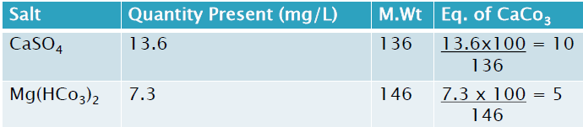
PROBLEM:
A sample of water gives an analysis 13.6 mg/L of CaSO4. 7.3 mg/L of Mg(HCO3)2. Calculate the total hardness and permanent hardness.
Solution:
The Total hardness of H2O = Temporary hardness + Permanent Hardness = 5 + 10 = 15 mg/L
Permanent hardness = 10 ppm (or) 10 mg/L
@Amare Aregahegn

Slide 21
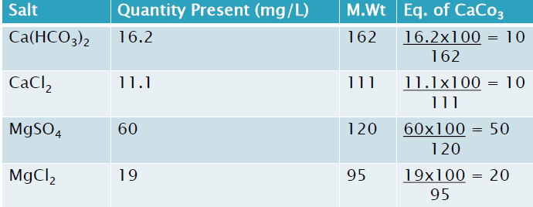
2. Calculate the total hardness of 1000 litre of a sample of water containing the following impurities 16.2 mg/L of Ca(HCO3), 11.1 mg/L of CaCl2, 60 mg/L of MgSO4 and Ca(HCO3)2, 11.1 mg/L of CaCl2, 60 mg/L of MgSO4 and 19 mg/L if MgCl2.
Solution:
Total hardness of H₂O = Temporary hardness + Permanent Hardness = 10 + 10 + 50 + 20 = 90 mg/L. Total hardness for 1000 liters = 90 x 1000 = 90,000 mg/L
@Amare Aregahegn

Slide 22
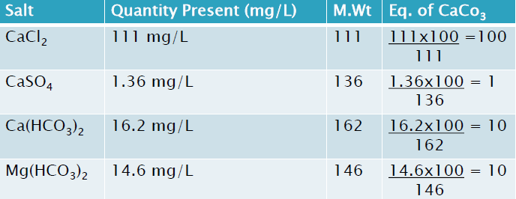
A Sample of hard water contains the following dissolved salts per litre. CaCl2 = 111 mgs, CaSO4 = 1.36 mgs, Ca(HCO3)2 = 16.2 mgs, Mg(HCO3)2 = 14.6 mgs, Silica = 40 gms, Turbidity = 10 mgs. Calculate the temporary, permanent and total hardness of water in ppm, ºcl & ºFr
Solution:
Note: Si & Turbidity must not be considered because they do not cause hardness to water.
Total hardness of H2O = Hardness of Ca(HCO3)2+ Mg(HCO3)2 in terms of CaCO3 equivalents = 10 + 10 = 20 mg/L
Permanent hardness = Hardness of CaCl₂+ CaSO₄ in terms of CaCO₃ equivalents
= 100 + 1 = 101 mg/L
@Amare Aregahegn

Slide 23
    Alkalinity:
is the increased concentration of OH-ions and this is due to either dissociation or hydrolysis.
Types of alkalinity: depending on HCO₃-, CO₃⁻² and OH- concentration, alkalinity can be classified into i) bicarbonate alkalinity (A_{b}), ii) carbonate alkalinity (A_{c}) and iii) hydrate alkalinity (A_{h}).
Or other classification: i) caustic alkalinity (CO₃⁻² and OH-) and ii) alkalinity due to temporary hardness (HCO₃-).
Why we analyze alkalinity of water? What happened if it present?
If it present, it produces steam in the boiler which causes corrosion. We have to avoid it by adding acids depending on the alkalinity (i.e. acid-base titration). We can check the presence of alkalinity by adding phenolphthalein (one drop), the color changes to pink but in water colorless.
@Amare Aregahegn

Slide 24
  2.3. Requisites of water for industrial purpose.
The quality and quantity of available water are important in the location of a chemical plant.
The most important factors in deciding the location of a chemical industry are: raw materials, power, water and transport. But as regards water, every industry has its own special requirements
In preparing water for industrial uses, softening (i.e., removing hardness) is an important step. If hard water is used in textile plants, laundries and other industries, where cleansing operations with soap are conducted, excessive soap consumption will take place
@Amare Aregahegn

Slide 25
Many industries such as paper, rayon, ice, brewing, distilleries, etc., need soft water. In canning, hard water causes toughening of some vegetables, notably beans and peas.
In textile finishing, hard water may produce undesirable reaction with dyes or cause spots on the fabrics. Hard water produces scale formation in pipe-lines and boilers, causing wastage of fuel and even failure of tubes leading to shut-downs and accidents.
Generally, water is used directly or indirectly in many industrial processes
@Amare Aregahegn

Slide 26
A proper quality of water must be used in boilers. If hard water is used as boiler feed water, the following problems may take place on boiler:-
  Scale formation
  Corrosion of boiler metal
  Caustic embrittlement
  Priming and foaming;
@Amare Aregahegn

Slide 27
  1. Scale formation:
When water containing suspended and dissolved solids is evaporated, then the suspended and dissolved materials get deposited in the boiler.
If these substances settle down and can be removed easily are called sludge. If they form adherent coatings on boiler surface, then they are known as scales.
The scales seriously restrict the efficiency of boilers, whereas sludges are not so much harmful unless present in large quantities.
@Amare Aregahegn

Slide 28


Causes of scale formation
When water is heated, bicarbonate are converted into carbonates by giving out carbon dioxide. Insoluble carbonates are precipitated out.
This is the main cause of scale formation in low pressure boilers. In high pressure boilers, the CaCO₃ reacts with water to give soluble calcium hydroxide and carbon dioxide.
@Amare Aregahegn

Slide 29
    b. Salts like calcium sulphate, calcium silicate and magnesium silicate are sparingly soluble in cold water but insoluble in super-heated water so they are precipitated at the heated portion of the boiler. This is the main cause of boiler scaling in high pressure boilers.
    c. Suspended matter and colloidal matter such as silica due to high temperature and concentration are precipitated in the boiler.
@Amare Aregahegn

Slide 30
Disadvantages of scale formation
The scale adheres to the boiler tubes, and as it is bad conductor of heat, it reduces heat transfer across the tube walls. So to maintain the required temperature due to overheating, wastage of fuel is involved
Due to continuous scaling, clogging of tubes takes place and so efficiency is reduced.
Due to over-heating, the tube metal becomes hotter so the boiler metal becomes more soft and weak. This makes the boiler unsafe at high pressures.
Due to high pressure of steam inside the boiler, the scale gets cracked and water rushes through these cracks and come in contact with the hot metal, with the liberation of hydrogen gas. Development of high pressure sometimes may cause explosion.
Considerable quantity of sludge may be entrapped within the scale. So narrow opening (like gauze, glass connections) may clog and retard the efficiency.
@Amare Aregahegn

Slide 31
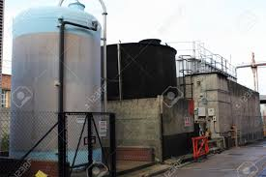
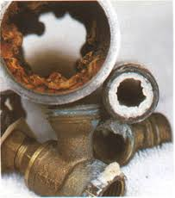
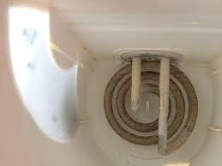
@Amare Aregahegn

Slide 32
Removal of sludge and scale deposits
As scale and sludge formation is harmful, it should be removed.
If the scales are loosely adhered to the inner wall of the boiler, then it can be removed by using knife blade or a piece of wood.
If the scale is brittle, it may be removed by mechanical blow
Chemicals are used to remove hard scale. Calcium carbonate scale can be removed by treating 5 to 10% of hydrochloric acid. Sulphate scale is dissolved in 5% of HCl.
@Amare Aregahegn

Slide 33
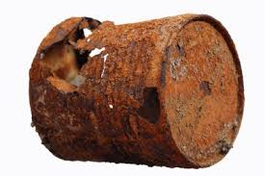

  II. Corrosion of boiler metal:
Corrosion is one of the most serious effects of impurities in boiler feed water. The main factors contributing toward corrosion are as follows:
Dissolved oxygen in feed water: Oxygen is the greatest cause of corrosion in boilers and accessories. This dissolved oxygen must be reduced to a minimum. Dissolved oxygen in presence of water and at high temperature attacks the material of the boiler.
@Amare Aregahegn

Slide 34
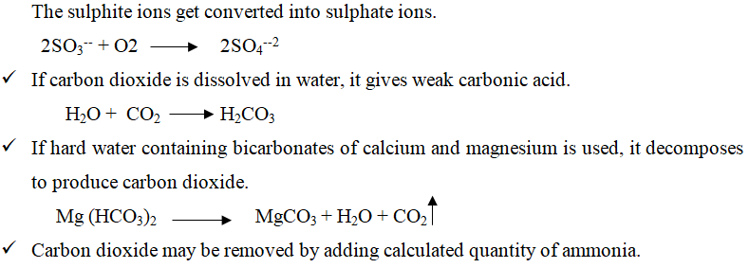
To remove dissolved oxygen, chemical treatment is given. Sodium sulphite can remove dissolved oxygen effectively if it is added to feed water long before it enters the boiler. The sulphite ions get converted into sulphate ions.
@Amare Aregahegn

Slide 35
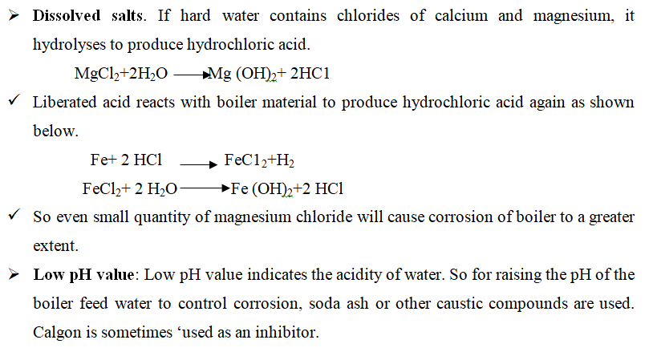
@Amare Aregahegn

Slide 36
  2.8. Treatment of water
Definition of Water Conditioning: Water conditioning is the process by which hard water, both temporary and permanent, is made soft (by total reduction or reducing the proportion of chemicals causing hardness) to be suitable for use as boiler feed water.
Conditioning is necessary for maximum output of steam and for protecting the life of boiler bodies, tubes and pipes by prevention of scale formation and corrosion.
Various water conditioning processes are employed: precipitation processes, ion exchange processes, demineralization, phosphate conditioning, etc.
The process of removing salts of calcium and magnesium from hard water is known as softening the water
@Amare Aregahegn

Slide 37
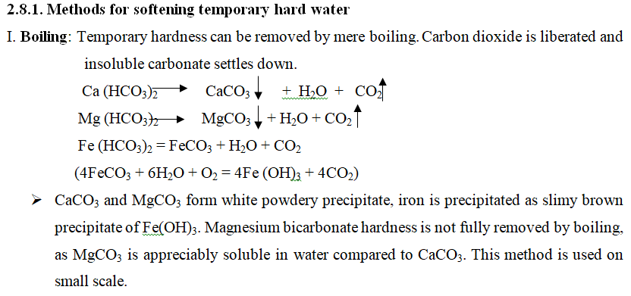
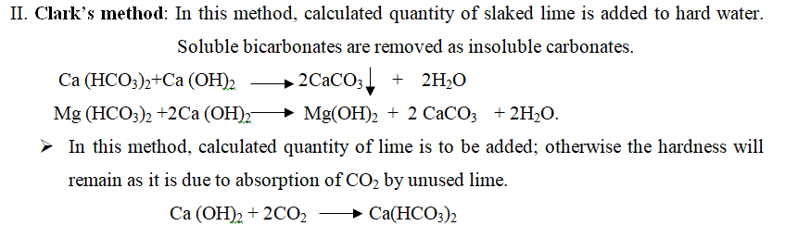
@Amare Aregahegn

Slide 38
    2.8.2. Methods of softening permanent hardness
The removal of hardness causing constituents like Ca²⁺, Mg²⁺ is known as water softening.
Permanent hard water not softened by mere boiling or adding slaked lime. Therefore, the following methods are used for softening it.
  Soda-ash process
  Lime-soda process
  Zeolite or permutit process
  Ion exchange or Deionization or Demineration process.
@Amare Aregahegn

Slide 39

    a. Soda-Ash process:
In this process, soda ash reacts with calcium and magnesium salts to form insoluble carbonates. Thus water is rendered soft.
If both types (Temporary and permanent) of hardness are present, then in addition to soda ash, caustic soda is also used.
@Amare Aregahegn

Slide 40
    b. Lime Soda Process (LS Process)
In this process Water is treated with lime followed by the addition of soda ash (Na₂CO₃) due to which calcium ions in the hard water are removed as CaCO₃, and magnesium ions as Mg (OH)₂.
This process is used for the removal of both temporary as well as permanent hardness and can be accomplished either in cold or in hot.
The cold lime process is used for partial softening of water, say from 100 ppm to 35 ppm of hardness. The hot lime soda process is used almost entirely for conditioning boiler feed water. The reactions involved are:
@Amare Aregahegn

Slide 41
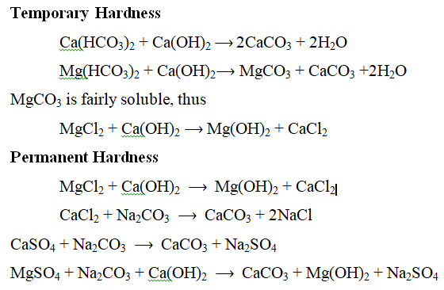
@Amare Aregahegn

Slide 42
Cold-Lime-Soda Process:
In this method, calculated quantity of chemicals (lime + soda) are mixed with water at atmospheric temperature.
To facilitate the precipitate to settle down easily, small amount of coagulant is added (like alum, sodium aluminate, etc.).
Process:
Water and calculated quantity of chemicals (lime + soda + coagulant) are fed from the top into inner vertical circular chamber fitted with rotating shaft carrying a number of paddles.
As the raw water and chemicals flow down due to vigorous stirring, softening of water takes place.
The softened water comes into the coaxial chamber, rises upwards. The heavy sludge settles down, and removed from the bottom of the outer chamber while the softened water passes through a wood fibre filter to ensure the complete removal of any residual sludge particles
@Amare Aregahegn

Slide 43
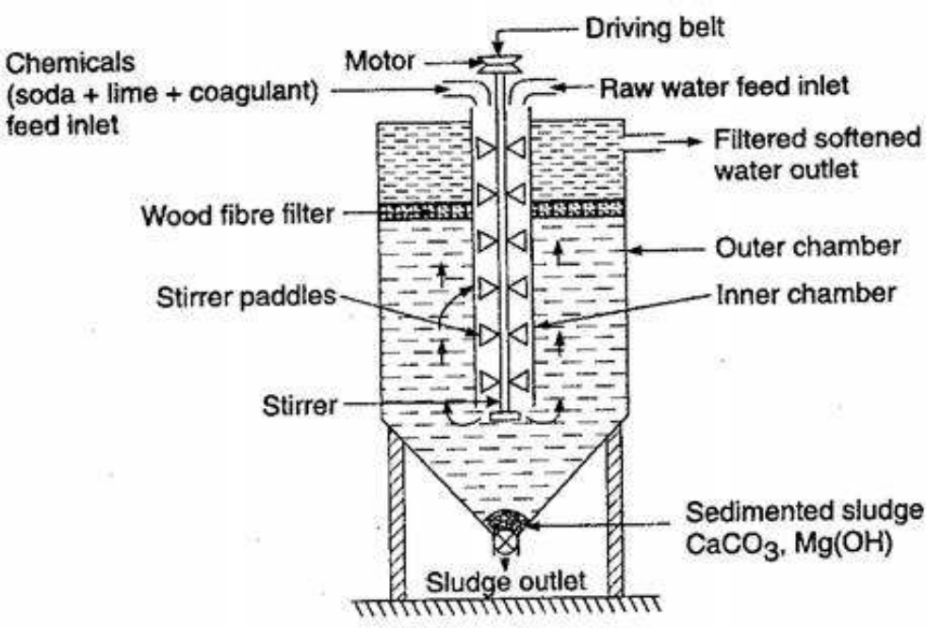
2
The softened water from this process contains a residual hardness of 50-60ppm.
@Amare Aregahegn

Slide 44
Hot-Lime-Soda Process:
This process is similar to the cold lime-soda process, but no coagulant is needed.
Here the process is carried at a temperature of 80 to 150 ºC.
Hot lime-soda plant consists of three parts:
A ‘reaction tank’ in which raw water, chemicals and steam are thoroughly mixed
A ‘conical sedimentation vessel’ in which sludge settles down, and
Sand filter which removes sludge from the softened water.
@Amare Aregahegn

Slide 45
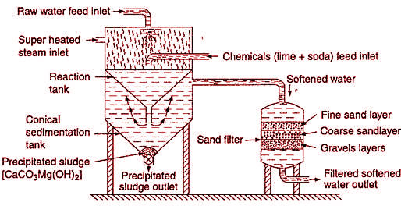
The softened water from this process contains a residual hardness of 15-30 ppm
@Amare Aregahegn

Slide 46
Advantages of HLS over CLS :
    The reaction takes at a faster rate.
    Softening capacity is increased many times.
    Coagulants are not required as the precipitate and sludge settles rapidly.
    Dissolved gases (such as CO₂, air etc.) are removed.
    Residual hardness of only 15 to 30 ppm.
@Amare Aregahegn

Slide 47
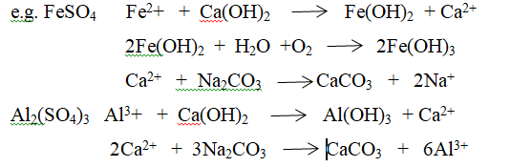
Coagulants like Al₂O₃ and FeSO₄ make the impurities to settle down the water tank.
Substances like NaCl, KCl, Na₂SO₄, SiO₂, Fe₂O₃ etc. don’t give any hardness and therefore these should not take into consideration to calculate the lime and soda requirement.
@Amare Aregahegn

Slide 48
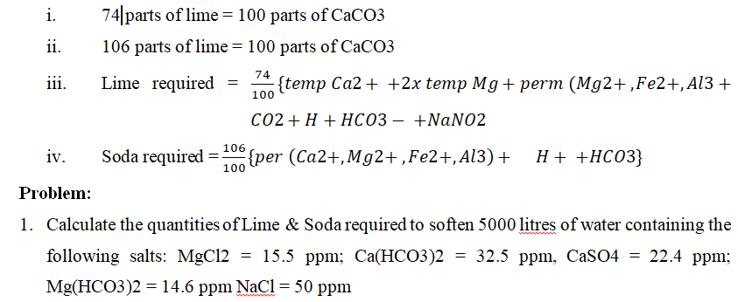
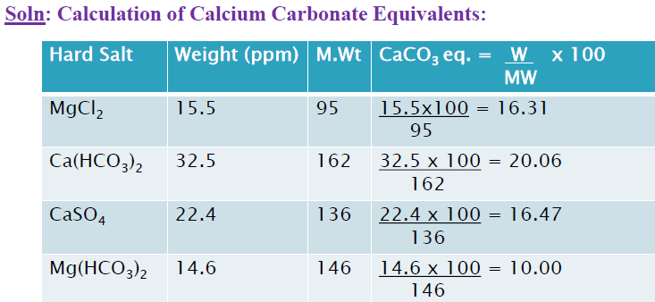
@Amare Aregahegn

Slide 49
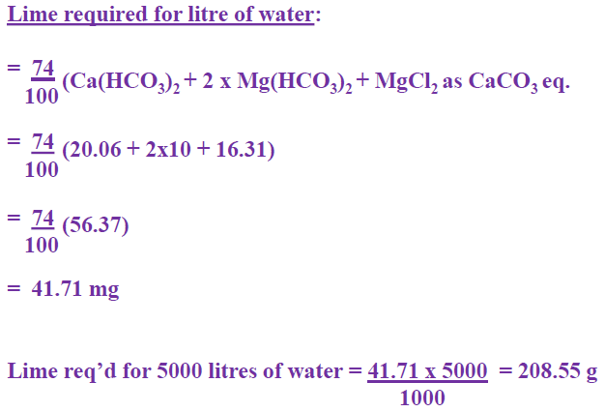
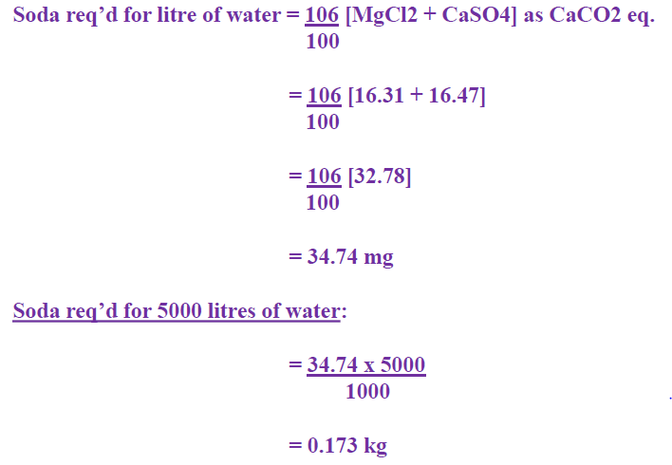
@Amare Aregahegn

Slide 50
    c. Permutit or Zeolite process
Zeolites, known as green sand are used for water softening. But artificial zeolite known as permutit is more common. Its general formula is Na₂O.Al₂O₃. nSiO₂. xH₂O.
Permutit or zeolite is insoluble in water but can act as base exchanger when brought in contact with water which contains cations. The zeolite or permutit is put in a suitable column and hard water which contains Ca⁺⁺ and Mg⁺⁺ ions is percolated through it. This is used to remove both temporary and permanent hardness.
In this process, water is softened with the help of a natural or artificial zeolite.
Permutit is an artificial zeolite, known as hydrate of sodium aluminum orthosilicate and can be obtained in the form of coarse sand by fusing together sodium carbonate (Na₂CO₃), alumina (Al₂O₃) and silica (SiO₂).
@Amare Aregahegn

Slide 51
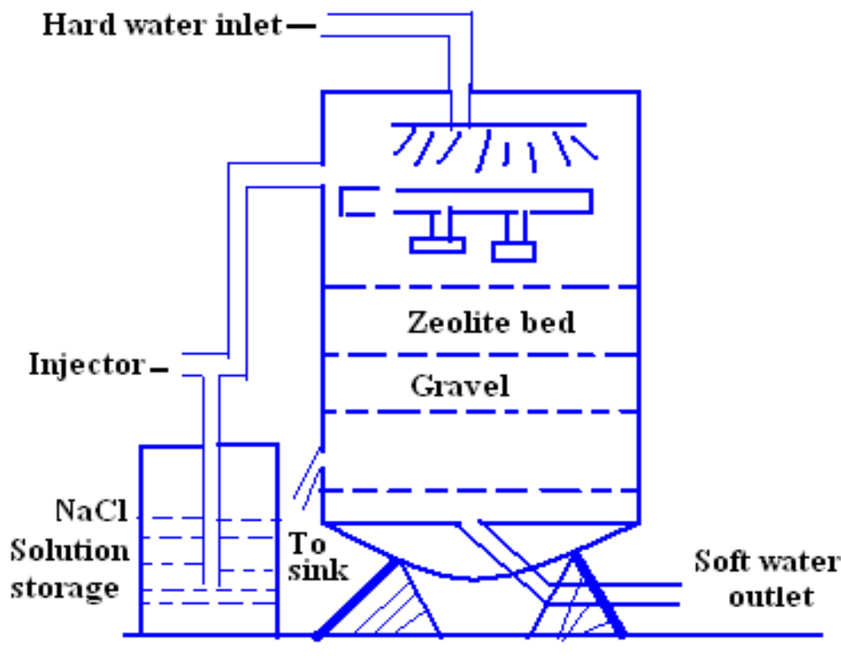
@Amare Aregahegn

Slide 52
Zeolite is “Hydrated sodium alumino silicate” Its general formula is: Na2O.Al2O3.xSiO2.yH2o, Here: x=2-10, y=2-6 e.g. Natrolite: Na2O.Al2O3.3SiO2.2H2o
Natural zeolites are generally non-porous
The artificial zeolite is called Permutit. These are prepared by heating together with chain clay, feldspar and soda ash.
These are porous and have greater softening capacity than natural zeolite.
They exchange Na+ ions with the hardness producing ions (Ca2+, Mg2+, etc.) in water.
Sodium Zeolite is denoted as Na2Ze
PROCESS: In this process hard water is passed through a bed of zeolite at ordinary temperature. The hard water percolates (filtered), Ca+2, Mg2+ present in hard water are exchanged with Na+ ions
The following reactions taking place:
@Amare Aregahegn

Slide 53
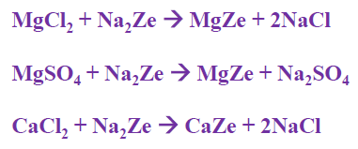
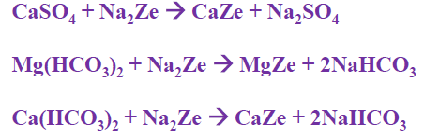

Regeneration of Zeolite:
On continuous passing of hard water through sodium zeolite bed it is converted to calcium and magnesium zeolite which is known as Exhausted Bed. Hence, it must be regenerated. This can be done by washing zeolite bed with 10% sodium chloride solution.
(Regenerated Zeolite)
@Amare Aregahegn

Slide 54
    d. Ion Exchange Process
Ion-exchange or Deionization or Demineralization Process - Recently ion-exchange resins have been used to remove all minerals from water. It is a process by which ions held on a porous, essentially insoluble solid are exchanged for ions in solution that is brought in contact with it.
An ion-exchange resin is a cross linked organic polymer network having some ionisable group.
A number of synthetic organic resins have been developed which can exchange cation and anion present in water.
In general, resin may be of two types depending upon the nature of the ionizable group.
@Amare Aregahegn

Slide 55
Cation Exchange Resin or Cation Exchanger - Such resins have - SO₃H, -- COOH or -OH (phenolic) group as the ionizable group. Since these resins exchange the cationic portion of minerals by their hydrogen atom, they are known as cation exchangers.
Anion Exchange Resin or Anion Exchanger – These resins have -NH₂, -NHCH₃, -N(CH₃)₂ or -OH group. They exchange the anionic portion of the minerals and they are known as anion exchanger
Ion exchange resins are insoluble, cross-linked, long chain organic polymers. The functional groups attached to the chains can exchange hardness producing cat-ions and an-ions present in the water.
@Amare Aregahegn

Slide 56
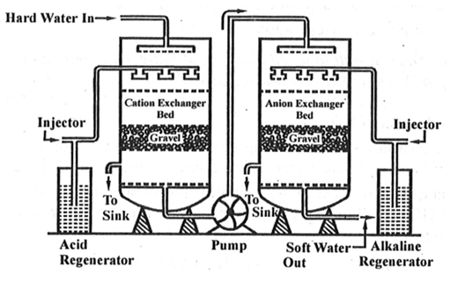
Figure 2.3 Ion Exchange Method
@Amare Aregahegn

Slide 57
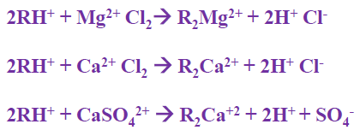
The process involves the following steps:
      1. The first chamber is packed with cat-ion exchange resin (RH+). When the hard water is passed through a bed of cation exchange resin it exchanges H+ with Ca+, Mg+2, K+, Na+ etc. of hard water.
Thus, the hardness producing cations (Ca2+, Mg2+ etc.) are removed
2. The second chamber is packed with anion exchange resin. The water coming out of the first chamber contains H+, Cl-, SO42- and HCO3- ions. It is now passed through anion exchange resin bed which can exchange OH- ions with anions like Cl-, SO₄²⁻ and HCO₃-
@Amare Aregahegn

Slide 58
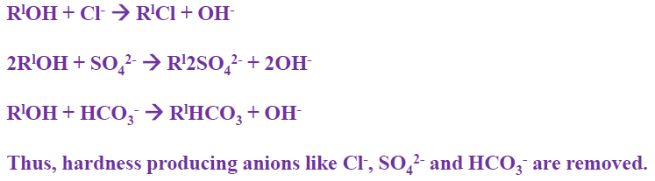
      3. Thus, H+ ions produced from first chamber combine with OH- ions produced from second chamber to form water. H+ + OH- → H2O, Hence, the water produced from ion-exchange process is completely free from all cations and anions of salts.
@Amare Aregahegn

Slide 59


Regeneration of resins: the resin bed gets exhausted, when used for a long period and can be regenerated:
(a) The exhausted cation exchange resin can be regenerated by passing dil. HCl (H+)
(b) The exhausted anion exchange resin can be regenerated by passing dil. NaOH (OH-)
Advantages:
  The softened water by this method is completely free from all salts and fit for use in boilers
  It produces very low hardness nearly 2 ppm
  Highly acidic or alkaline water can be treated by this process
Disadvantages:
  The equipment is costly
  More expensive chemicals are required for regeneration
  Turbid water cannot be treated by this method
@Amare Aregahegn

Slide 60
Water for domestic use
The following are the specification of water drinking purpose:
This water should be clear, colorless and odourless.
The water must be free from pathogenic bacteria and dissolved gases like H₂S.
The optimum hardness of water must be 125 ppm and pH must be 7.0 to 8.5
The turbidity in drinking water should not exceed 25 ppm
The recommended maximum concentration of total dissolved solids in potable water must not exceed 500 ppm.
@Amare Aregahegn

Slide 61
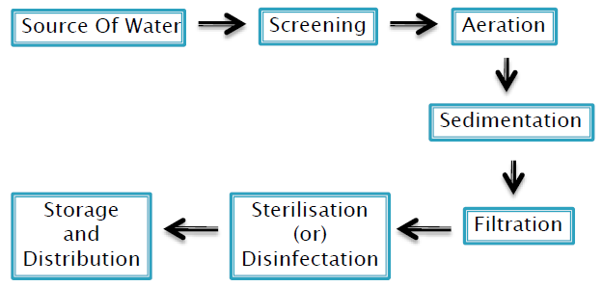
Treatment of water for municipal supply:
The treatment of water for drinking purposes mainly includes the removal of suspended impurities, colloidal impurities and harmful pathogenic bacteria.
Various stages involved in purification of water for Municipal Supply:
@Amare Aregahegn

Slide 62
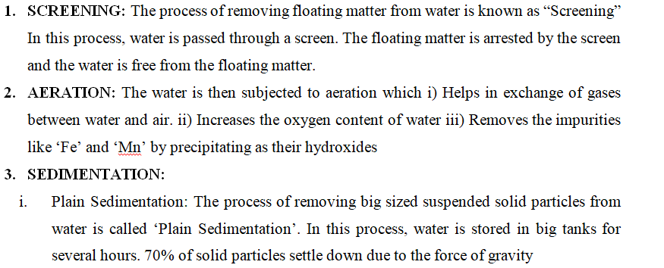
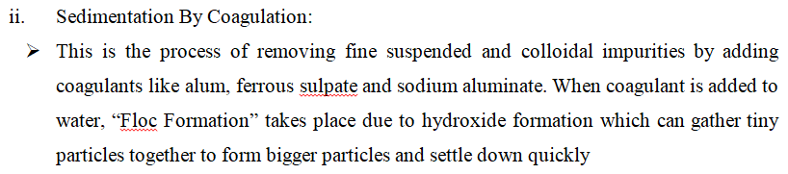
@Amare Aregahegn

Slide 63
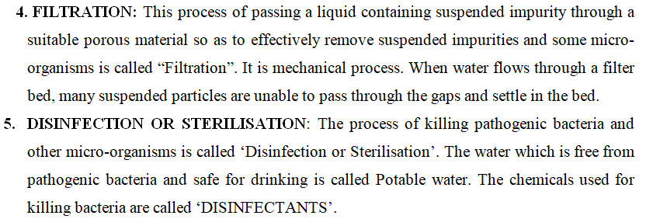
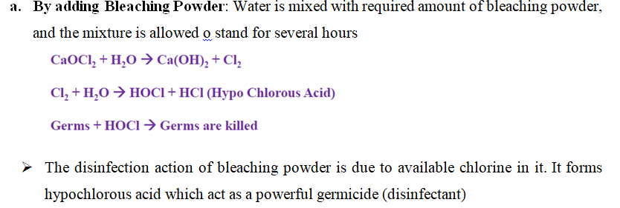
@Amare Aregahegn

Slide 64
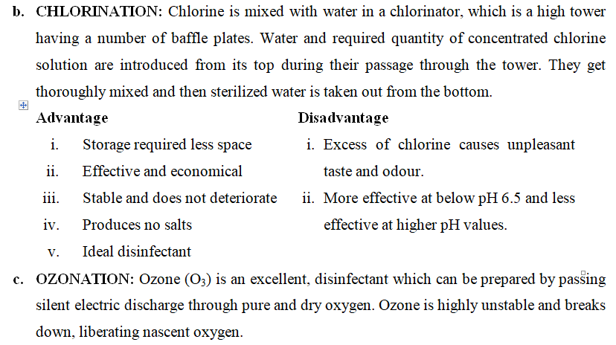
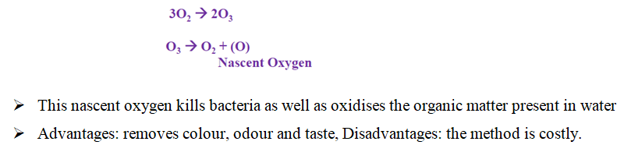
@Amare Aregahegn

Slide 65

Thank you for
your attention!!!
@Amare Aregahegn

